Slide 1
Material Science MATS201 Module II

Slide 2

Stress
Stress is defined as force per unit area within materials that arise from externally applied forces, uneven heating, or permanent deformation and that permits an accurate description and prediction of elastic, plastic, and fluid behavior.
Stress is given by the following formula:
$$σ=\frac{F}{A}$$

Slide 3
Types of Stress
Stress applied to a material can be of two types as follows:
Tensile Stress
Tensile stress is the force applied per unit area, increasing a body’s length (or area). Objects under tensile stress become thinner and longer.
Compressive Stress
Compressive stress is the force applied per unit area, which decreases the length (or area) of a body. The object under compressive stress becomes thicker and shorter.

Slide 4

Strain
Strain is the amount of deformation experienced by the body in the direction of force applied, divided by the initial dimensions of the body.
The following equation gives the relation for deformation in terms of the length of a solid:
$$ϵ=\frac{δl}{L}$$
where, ϵ is the strain due to stress applied, δl is the change in length and L is the original length of the material.

Slide 5
Types of Strain
Strain experienced by a body can be of two types depending on stress application as follows:
Tensile Strain
Tensile strain is the change in length (or area) of a body due to the application of tensile stress.
Compressive Strain
Compressive Strain is the change in length (or area) of a body due to the application of compressive strain.

Slide 6
Stress-Strain Curve
When we study solids and their mechanical properties, information regarding their elastic properties is most important.
We can learn about the elastic properties of materials by studying the stress-strain relationships, under different loads, in these materials.
The material’s stress-strain curve gives its stress-strain relationship.
In a stress-strain curve, the stress and its corresponding strain values are plotted.

Slide 7
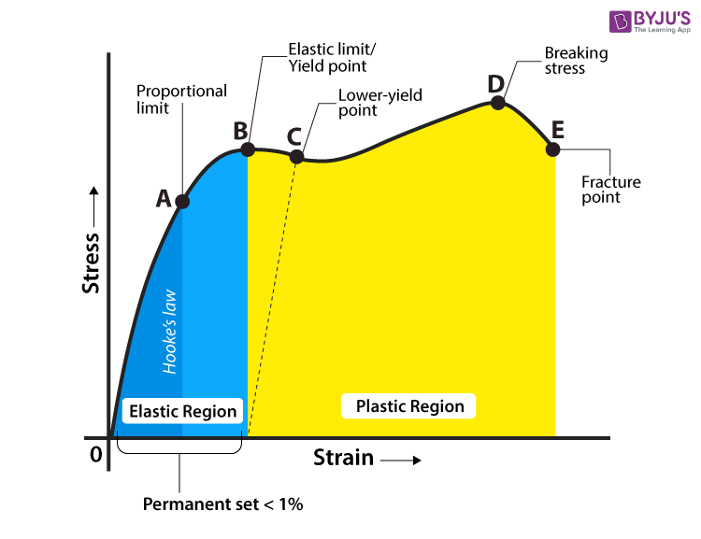
An example of a stress-strain curve is given below.

Slide 8
Proportional Limit
It is the point in the graph up to which the material returns to its original position when the load acting on it is completely removed.
Beyond this limit, the material doesn’t return to its original position, and a plastic deformation starts to appear in it.
Elastic Limit
It is the point in the graph up to which the material returns to its original position when the load acting on it is completely removed. Beyond this limit, the material doesn’t return to its original position, and a plastic deformation starts to appear in it.

Slide 9
Yield point
The yield point is defined as the point at which the material starts to deform plastically. After the yield point is passed, permanent plastic deformation occurs.
There are two yield points (i) upper yield point (ii) lower yield point.
iv. Ultimate stress point
It is a point that represents the maximum stress that a material can endure before failure. Beyond this point, failure occurs.
v. Fracture or breaking point
It is the point in the stress-strain curve at which the failure of the material takes place.

Slide 10
Hooke’s Law
Hooke’s Law states that the strain of the material is proportional to the applied stress within the elastic limit of that material.
Mathematically, Hooke’s law is commonly expressed as:
F = –k.x
Where F is the force, x is the extension length, and k is the constant of proportionality known as spring constant in N/m.

Slide 11

Young’s Modulus
Young’s modulus is also known as modulus of elasticity and is defined as the mechanical property of a material to withstand the compression or the elongation with respect to its length.
It is denoted as E or Y.
$$E=\frac{σ}{ϵ}$$

Slide 12

$$E=\frac{\frac{F}{A}}{\frac{δl}{L}}=\frac{FL}{Aδl}$$
Where,
E is Young’s modulus in Pa,
𝞂 is the uniaxial stress in Pa,
ε is the strain or proportional deformation,
F is the force exerted by the object under tension,
A is the actual cross-sectional area,
δL is the change in the length and
L is the actual length

Slide 13
A solid object deforms when a particular load is applied to it. If the object is elastic, the body regains its original shape when the pressure is removed.
Many materials are not linear and elastic beyond a small amount of deformation. The constant Young’s modulus applies only to linear elastic substances.
The Young’s Modulus values of different material are given below:
Steel – 200 X 10⁹ N/m²
Glass – 65 X 10⁹ N/m²
Wood – 13 X 10⁹ N/m²
Plastic (Polystyrene) – 3 X 10⁹ N/m²

Slide 14
Bulk Modulus of Elasticity
Bulk modulus is defined as the proportion of volumetric stress related to the volumetric strain of specified material, while the material deformation is within the elastic limit.
The value is denoted with a symbol of K and it has the dimension of force per unit area.
It is expressed in the units per square inch (psi) in the English system and newtons per square meter (N/m²) in the metric system.

Slide 15
It is given by the ratio of pressure applied to the corresponding relative decrease in the volume of the material.
Mathematically, it is represented as follows:
K = ΔP /(ΔV/V)
Where: K: Bulk modulus,
ΔP: change of the pressure or force applied per unit area on the material,
ΔV: change of the volume of the material due to the compression
V: Initial volume of the material in the units of in the English system and N/m² in the metric system.

Slide 16
What is the bulk modulus of a body that experienced a change of pressure of 5*10⁴N/m² and its volume goes from 4 cm³ to 3.9 cm³?

Slide 17
Shear Modulus
Shear modulus also known as Modulus of rigidity is the measure of the rigidity of the body, given by the ratio of shear stress to shear strain. Often denoted by G sometimes by S or μ.
It can be used to explain how a material resists transverse deformations but this is practical for small deformations only, following which they are able to return to the original state.
This is because large shearing forces lead to permanent deformations (no longer elastic body).

Slide 18
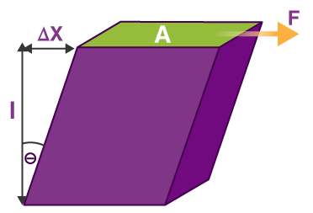

$$G=\frac{τ_{xy}}{γ_{xy}}=\frac{F/A}{{∆x}/l}=\frac{Fl}{A∆x}$$
Where, τ is shear stress, F is the force acting on the object, A is the area on which the force is acting, γ is the shear strain, Δx is the transverse displacement and l is the initial length. The modulus of rigidity is measured using the SI unit pascal or Pa.

Slide 19
The following example will give you a clear understanding of how the shear modulus helps in defining the rigidity of any material.
Shear modulus of wood is 6.2×10⁸ Pa
Shear modulus of steel is 7.2×10¹⁰ Pa
Thus, it implies that steel is a lot more (really a lot more) rigid than wood, around 127 times more!

Slide 20
A block of unknown material kept on a table (The square face is placed on the table.), is under a shearing force. The following data is given, calculate the shear modulus of the material.
Dimensions of the block = 60 mm x 60 mm x 20 mm
Shearing Force = 0.245 N
Displacement = 5 mm

Slide 21
Poisson’s Ratio
Poisson’s ratio is “the ratio of transverse contraction strain to longitudinal extension strain in the direction of the stretching force.”
Here,
Compressive deformation is considered negative
Tensile deformation is considered positive.

Slide 22
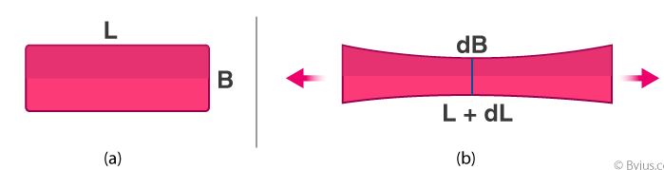
Imagine a piece of rubber, in the usual shape of a cuboid. Then imagine pulling it along the sides. What happens now?
It will compress in the middle. If the original length and breadth of the rubber are taken as L and B respectively, then when pulled longitudinally, it tends to get compressed laterally. In simple words, length has increased by an amount dL and the breadth has increased by an amount dB.

Slide 23

In this case,
$$ε_{t}=−\frac{dB}{B}$$
$$ε_{l}=−\frac{dL}{L}$$
The formula for Poisson’s ratio is,
$$μ=\frac{Transverse train}{Longitudal strain}=−\frac{ε_{t}}{ε_{l}}$$

Slide 24

Relation between Elastic Constants
The elastic moduli of a material, like Young’s Modulus, Bulk Modulus, Shear Modulus are specific forms of Hooke’s law, which states that, for an elastic material, the strain experienced by the corresponding stress a applied is proportional to that stress.
Thus, we can write the relation between elastic constants by the following equation:
$$E=2G(1+μ)=3K(1−2μ)$$

Slide 25
Ductile materials
Ductility is a physical property of a material that is associated with the ability to be hammered thin or stretched into wire without breaking.
The materials having this property are known as ductile materials. A ductile material can easily be drawn into wires.
Metals are the best examples of ductile materials. For example, gold, silver, copper are ductile. Although aluminum is a metal, it is not ductile. The ductility of metals can be high or low. Copper is highly ductile and can be drawn into thin wires without breakage.

Slide 26
Brittle materials
The term brittle describes materials that are easily broken, cracked, or snapped.
Materials break when a stress is applied to them.
Brittle materials break without any deformation. Therefore, they cannot be stretched like ductile substances.

Slide 27
The breaking of brittle substances objects with a snapping sound.
When these objects are broken, the edges fit each other because there is no deformation before breakage.
Many materials such as ceramic and glass are brittle.
Even steel become brittle at low temperatures.

Slide 28
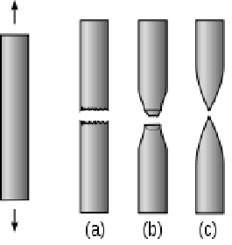
In this figure you can observe materials (a) break without losing its cross-section area means materials is brittle. This type of materials fail suddenly without any notice.
Failure of material (b) shows, it’s a ductile material. Ductile materials reduced its cross-section before rapture. Material (c) it’s called complete ductile materials.

Slide 29
Fracture
Fracture is the separation of a material into two or more pieces under the action of an applied stress.
A material may undergo one of two major types of fracture modes depending on its mechanical properties: ductile and brittle.
Materials undergoing ductile fracture first experience plastic deformation, i.e., the material resists the fracture by stretching itself.

Slide 30
Imagine pulling on two ends of a plastic bag.
The bag stretches by a considerable amount before it eventually tears.
This plastic deformation, which is not limited to polymers, is also seen in metal alloys.
Materials that undergo brittle fracture, on the other hand, will fracture with negligible plastic deformation.
In other words, they break without warning.

Slide 31
Regardless of the type of fracture, during failure a material will experience:
Crack formation, where all fractures start, and
Propagation of the crack, in response to the applied stress

Slide 32
In ductile fractures, this crack is stable, i.e., it will undergo continuous deformation, only propagating when more stress is applied.
As such, ductile materials will typically deflect by a significant amount before they fail, thus giving warning before they fracture entirely.

Slide 33
On the other hand, when cracks form under brittle fracture, they propagate across the material instantaneously; thus, failure can occur with little to no warning.
This is one of the characteristics that makes brittle failure so undesirable, especially in applications such as building construction.

Slide 34
Fatigue
Material fatigue is a phenomenon where structures fail when subjected to a cyclic load.
This type of structural damage occurs even when the experienced stress range is far below the static material strength.
Fatigue is the most common source behind failures of mechanical structures.

Slide 35
Stages of Fatigue
The process until a component finally fails under repeated loading can be divided into three stages:
During a large number of cycles, the damage develops on the microscopic level and grows until a macroscopic crack is formed.
The macroscopic crack grows for each cycle until it reaches a critical length.
The cracked component breaks because it can no longer sustain the peak load.

Slide 36
Fatigue Variables
Under the influence of a nonconstant external load, the state in the material also varies with time.
The state at a point in the material can be described by many different variables such as stress, strain, or energy dissipation.
The fatigue process is typically viewed as controlled by a specific such variable.
A load cycle is defined as the duration from one peak in the studied variable to the next peak.

Slide 37
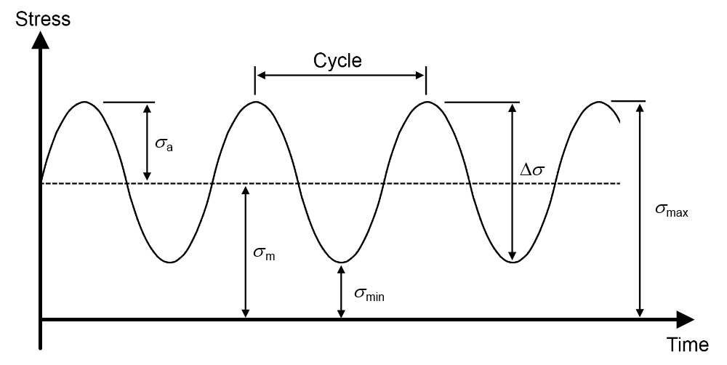
The stress varies between a maximum stress, σ_{max} , and a minimum stress, σ_{min} , during a load cycle. In the field of fatigue, the variation in stress is often defined using the stress amplitude, σ_{a} , and the mean stress, σ_{max}. Further, variables defining the stress range, Δσ, and the R-value are frequently used to describe a stress cycle.

Slide 38

The relation between the different fatigue stress variables is
$$σ_{m}=\frac{σ_{max}+σ_{min}}{2}$$
$$σ_{a}=\frac{σ_{max}−σ_{min}}{2}$$
$$∆σ=σ_{max}−σ_{min}$$
$$R=\frac{σ_{min}}{σ_{max}}$$

Slide 39
Creep
Creep is the time-dependent deformation below the strength of the material yield of a material under constant stress.
It is a high-temperature gradual deformation due to continual stress.
“High temperature” is a relative term that depends on the materials involved.
Creep rates are essential for evaluating boiler materials, gas turbines, jet engines, sheets, or any high-temperature application. Understanding the high-temperature behaviour of metals helps design systems that are resistant to failure.

Slide 40
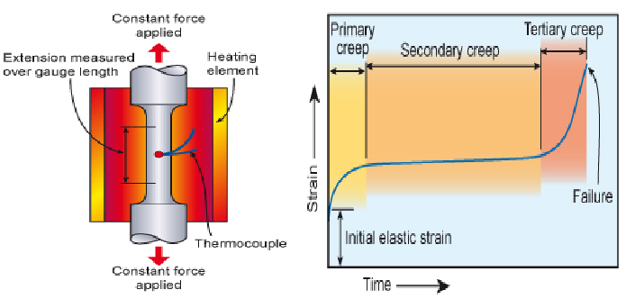
Stages of Creep
Primary or Stage I
Secondary or Stage II
Tertiary or Stage III

Slide 41
In Stage I or Primary Creep occurs at the beginning of the tests, and creeping is mostly transient, not steady. Resistance to creep progress until Stage II.
In Stage II or Secondary Creep, the quality of Creep is more or less constant. This stage is known as a steady-state Creep.
In Stage III or Tertiary Creep, the creeping rate begins to accelerate as the specimen’s cross-section area decreases due to nesting or internal nesting and decreases its practical size.
The fracture will occur if stage III is allowed to progress.

Slide 42
Hardness
Hardness is defined by the resistance of a material to plastic deformation, usually by indentation.
This also refers to the resistance to scratching, abrasion or cutting.
There are several globally approved tests to measure hardness.

Slide 43
Hard materials are scratchproof.
Hardness depends on the strength and the plasticity of the material. Higher the hardness, longer the lifetime of the material.
Examples of Hard Materials
Diamond which is an allotrope of carbon was considered as the hardest material on earth. It was used not only in jewelry manufacturing but also for various machinery. Diamond is also used to cut glasses, ceramic, etc.

Slide 44
Toughness
Toughness relates to the resistance of a material to fracturing;
this depends on the energy absorbed during fracturing, which in turn depends on the size of the material.
The amount of energy absorbed per unit area is characteristic of the material.
Tough material like mild steel is not easy to be cracked or broken.

Slide 45
Toughness depends on the ability of the material to be deformed under pressure, which is known as ductility.
However, not all ductile materials are strong.
Toughness is a combination of strength and ductility.
For a material to be tough, both ductility and strength should be high.
Material toughness has the units of energy per volume.

Slide 46
Factors that Affect Toughness
The rate of loading- Toughness decreases with the decrease of rate of loading
Temperature – When temperature is decreased, ductility decreases, hence toughness decreases
Notch effect – When force is applied on one axis a certain material may be able to withhold it, however, when force is applied multi-axially the material may fail to do so.

Slide 47
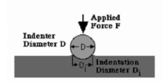
Brinell hardness test
The Brinell hardness test method consists of indenting the test material with a 10 mm diameter hardened steel or carbide ball subjected to a load of 3000 kg.

Slide 48
For softer materials the load can be reduced to 1500 kg or 500 kg to avoid excessive indentation.
The full load is normally applied for 10 to 15 seconds in the case of iron and steel and for at least 30 seconds in the case of other metals.
The diameter of the indentation left in the test material is measured with a low powered microscope.

Slide 49

The Brinell harness number is calculated by dividing the load applied by the surface area of the indentation.
$$BHN=\frac{F}{\frac{π}{2}D.(D−\sqrt{D^{2}−{D_{i}}^{2}}}$$

Slide 50
T
”

Slide 51
T
The diameter of the impression is the average of two readings at right angles and the use of a Brinell hardness number table can simplify the determination of the Brinell hardness.
A well structured Brinell hardness number reveals the test conditions, and looks like this, "75 HB 10/500/30" which means that a Brinell Hardness of 75 was obtained using a 10mm diameter hardened steel with a 500 kilogram load applied for a period of 30 seconds.

Slide 52
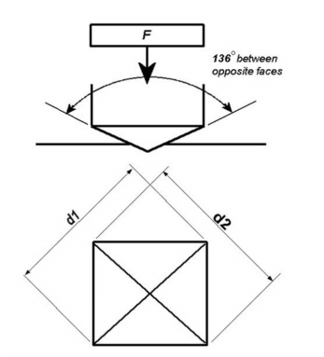
Vickers hardness test
The Vickers hardness test method consists of indenting the test material with a diamond indenter, in the form of a right pyramid with a square base and an angle of 136 degrees between opposite faces subjected to a load of 1 to 100kgf. The full load is normally applied for 10 to 15 seconds.

Slide 53

The two diagonals of the indentation left in the surface of the material after removal of the load are measured using a microscope and their average calculated.
The Vickers hardness is the quotient obtained by dividing the kgf load by the square mm area of indentation.
$$HV=\frac{2Fsin\frac{136}{2}}{d^{2}}$$
$$HV≈1.854\frac{F}{d^{2}}$$
The Vickers hardness should be reported like 800 HV/10, which means a Vickers hardness of 800, was obtained using a 10 kgf force.

Slide 54
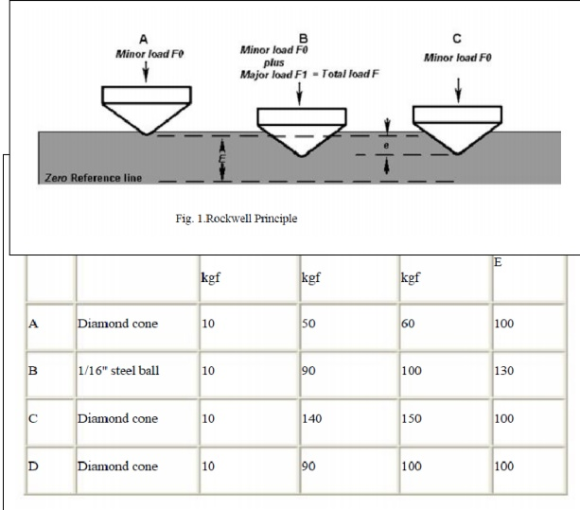
Rockwell Hardness Test
The Rockwell hardness test method consists of indenting the test material with a diamond cone or hardened steel ball indenter.
The indenter is forced into the test material under a preliminary minor load F0 usually 10 kgf.

Slide 55
When equilibrium has been reached, an indicating device, which follows the movements of the indenter and so responds to changes in depth of penetration of the indenter is set to a datum position.
While the preliminary minor load is still applied, an additional major load is applied with resulting increase in penetration.
When equilibrium has again been reach, the additional major load is removed but the preliminary minor load is still maintained.

Slide 56
Removal of the additional major load allows a partial recovery, so reducing the depth of penetration.
The permanent increase in depth of penetration, resulting from the application and removal of the additional major load is used to calculate the Rockwell hardness number.

Slide 57

$$HR=E−e$$
F0 = preliminary minor load in kgf,
F1 = additional major load in kgf, F = total load in kgf,
e = permanent increase in depth of penetration due to major load F1 measured in units of 0.002 mm,
E = a constant depending on form of indenter: 100 units for diamond indenter, 130 units for steel ball indenter, and
HR = Rockwell Hardness number.

Slide 58
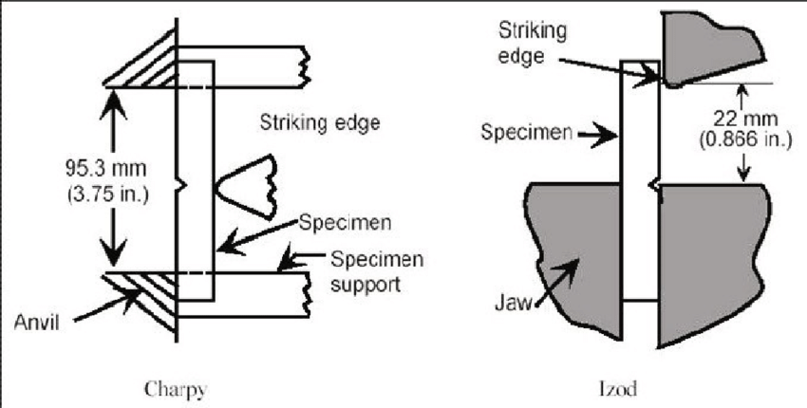
Charpy impact toughness test
The Charpy impact test makes use of a pendulum arm attached to a precalibrated energy gauge.
The material specimen is customised to take the shape of a bar with a small V- or U-shaped notch in the middle.

Slide 59
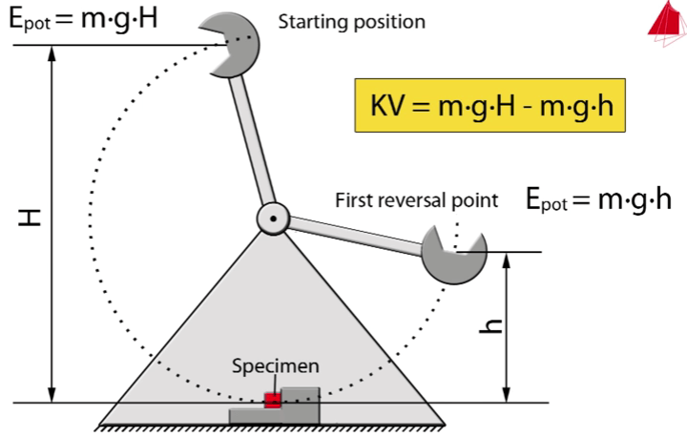
To conduct the experiment, the pendulum arm is set at a particular position correspondent to an energy setting.
The arm is released and its hammer end is allowed to hit the centre of the specimen. The impact strength of the material is determined by the amount of energy needed to break or fracture the specimen.

Slide 60
Izod impact toughness test
While the specimen is set horizontally in the Charpy impact test, the Izod test examines a vertically positioned sample with a V-Notch.
Here, the pendulum hammer is made to strike the upper tip of the notched specimen.

Slide 61
Other differences include the specimen size, notch face direction, type of hammer, and type of tested material.
The Charpy test examines metal specimens with the notch facing away from a striking ball peen hammer.
The Izod test, on the other hand, is used to test relatively longer metal or plastic specimens with the notch facing towards a farming hammer.

Slide 62
End of Module II Thank You

